Slide 1
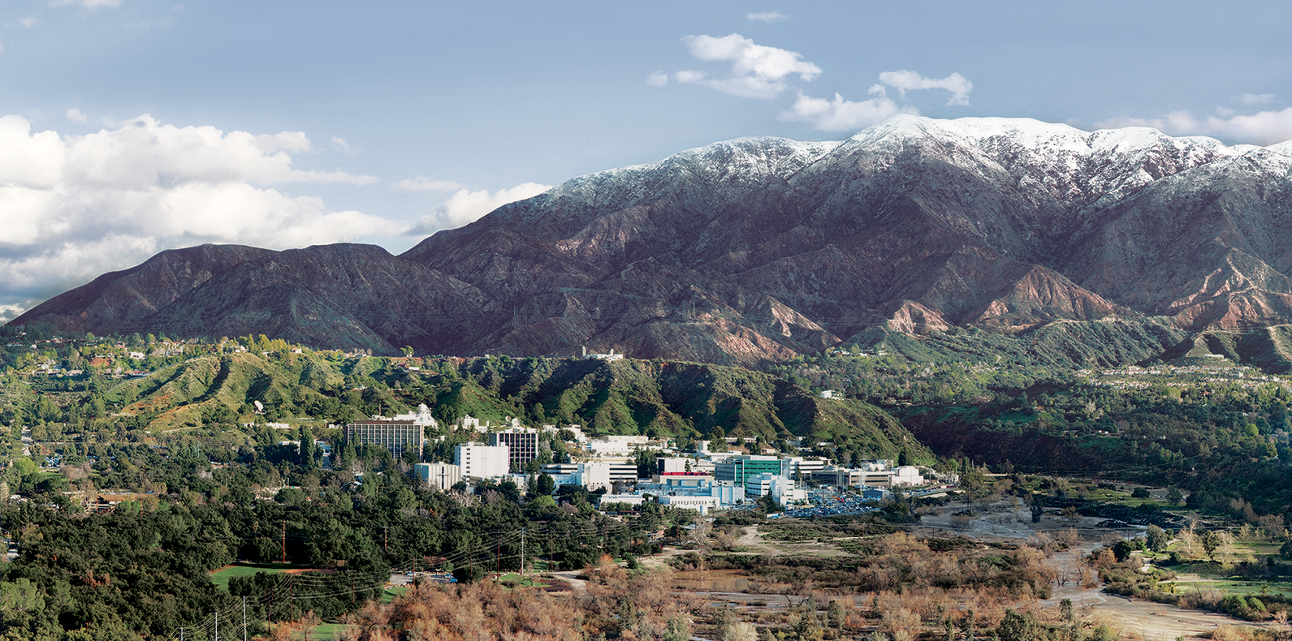
8. Spectral Calibration
Dr. David R. Thompson
Jet Propulsion Laboratory, Imaging Spectroscopy Group
July 20, 2019

Slide 2
Goals for this module
Describe common distortions caused by physical misalignments in spectrometers
Recognize, characterize and correct spectral calibration error in flight data

Slide 3
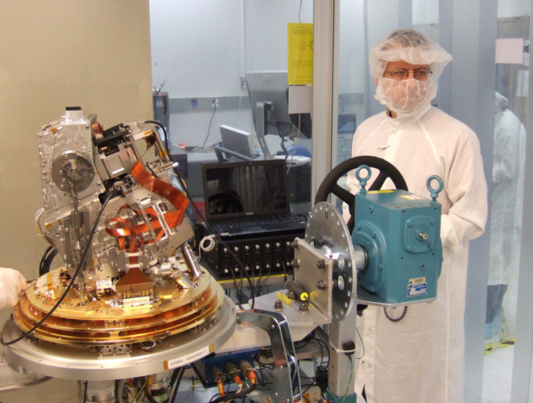
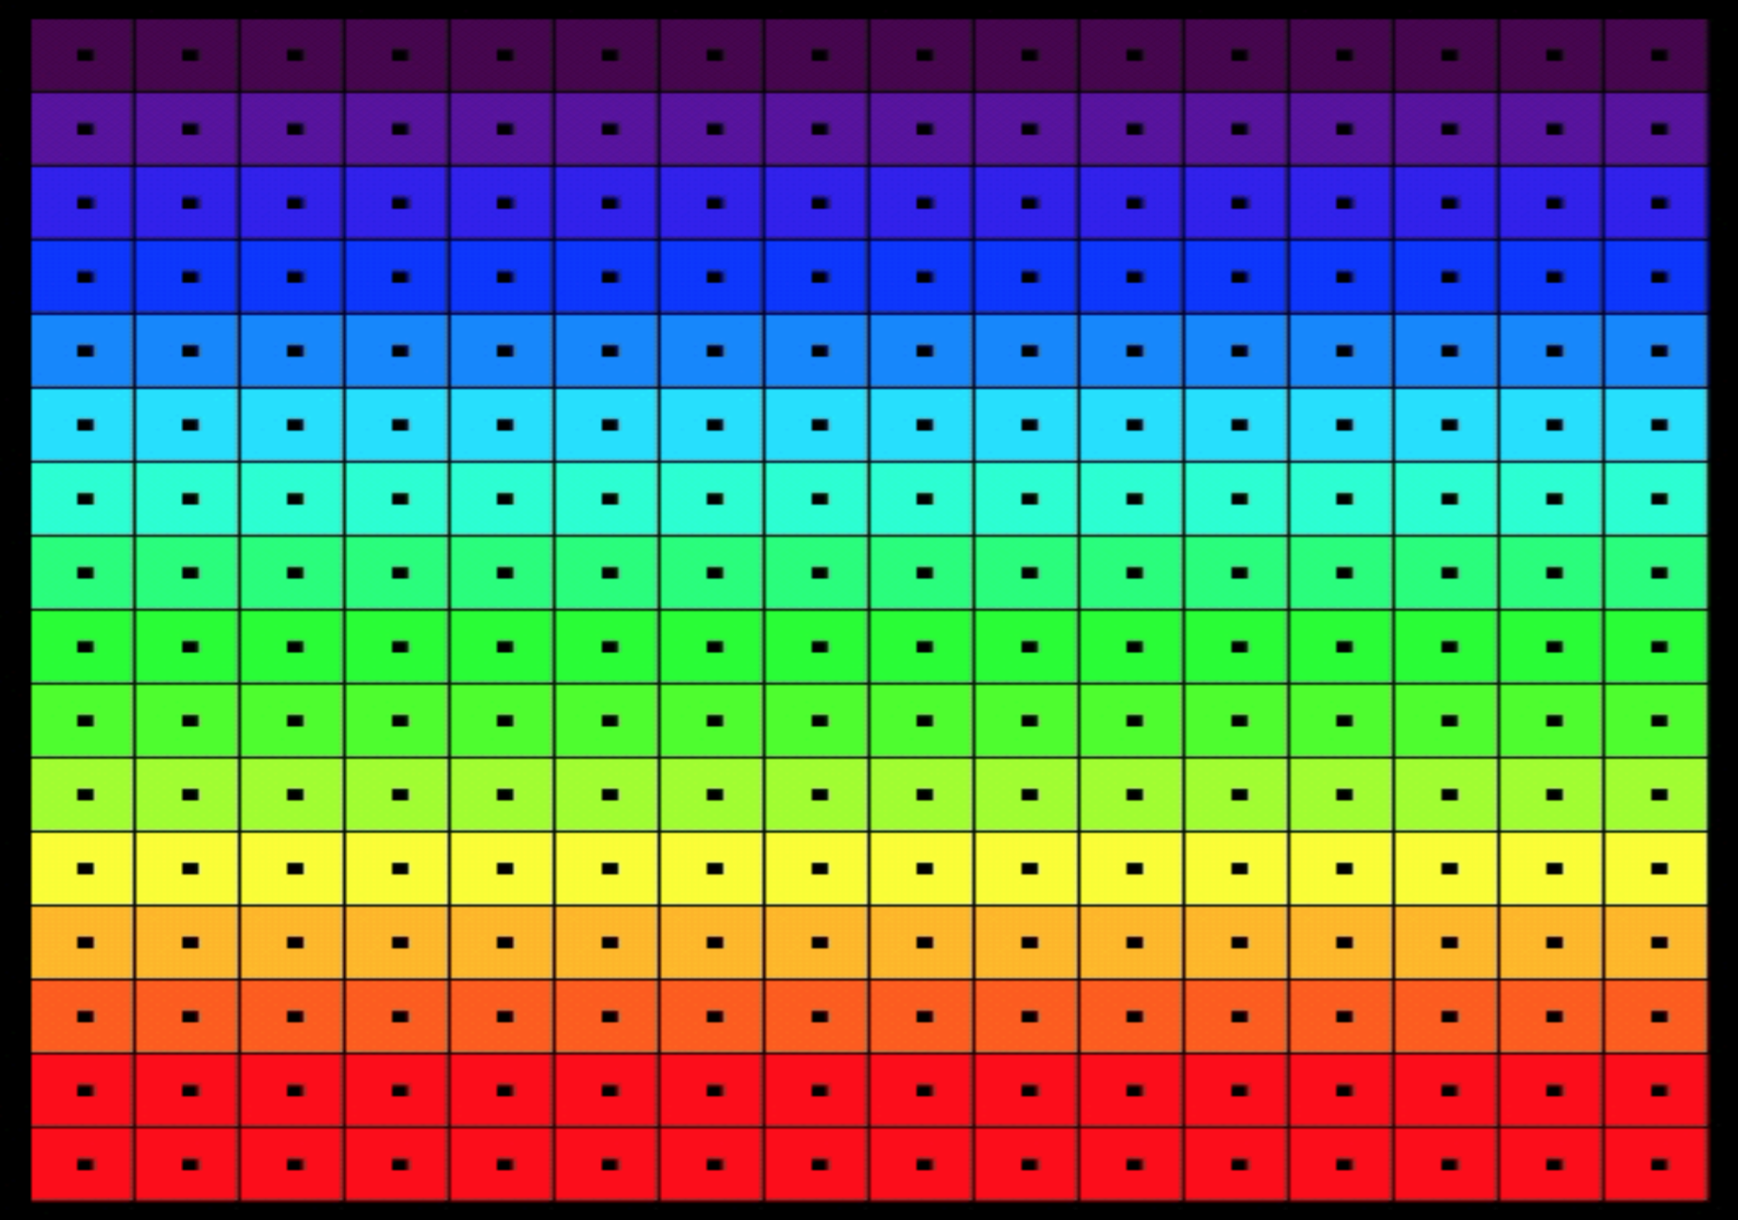
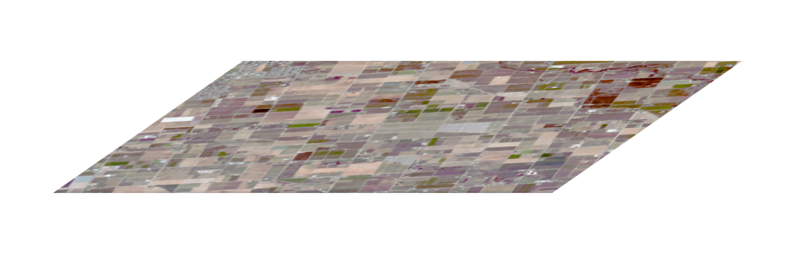
Conventions
Rows (spectral channels)
FPA
Spectrometer
Slit
Telescope
Samples (cross-track locations)

Slide 4
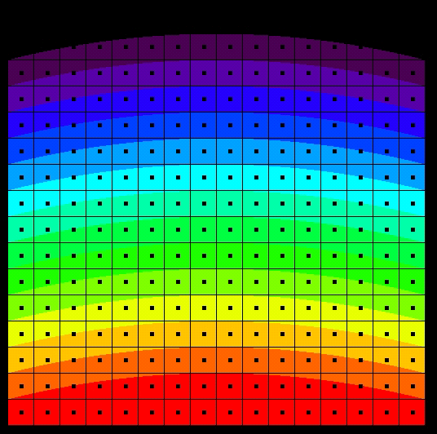
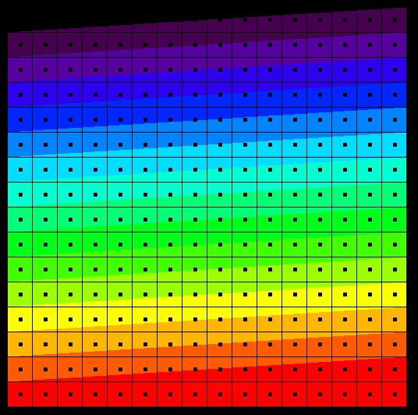
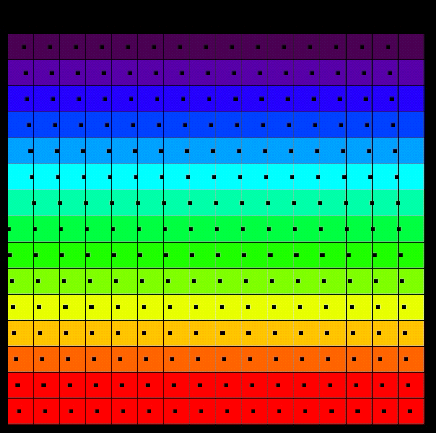
Flavors of non-uniformity
Cross Track Sample
Wavelength
Requirement
Failure by Frown
Wavelength
courtesy
Robert O. Green, JPL
Failure by Twist
Failure by Spectral-IFOV-Shift

Slide 5
Wavelength fitting: use the atmosphere as an in-flight calibration standard
Courtesy Robert O. Green

Slide 6
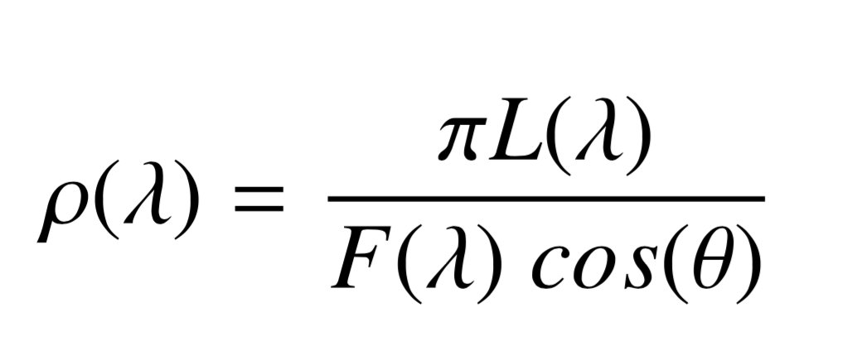
Wavelength tuning with the atmosphere
1. Calculate an average Top of Atmosphere reflectance for each cross-track position:
Measured radiance
Solar irradiance
Solar zenith

Slide 7
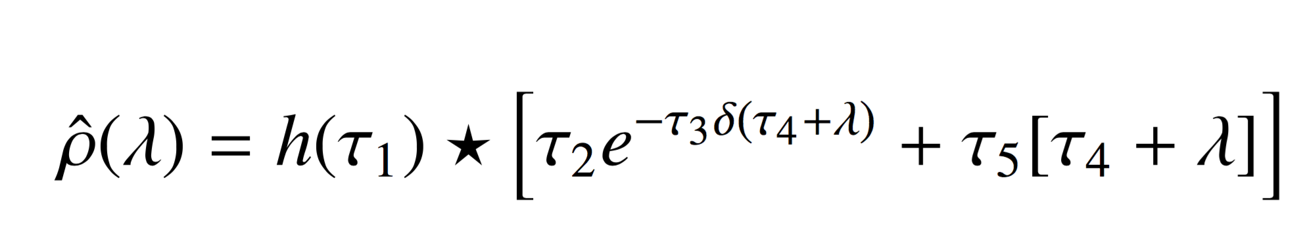
Wavelength tuning (contd.)
2. Calculate absorption coefficients using an appropriate Radiative
Transfer Model (I use 6s or MODTRAN).
3. Optimize continuum and absoprtion depth via Levenberg-Maquardt gradient descent:
shift
width
A linear continuum

Slide 8
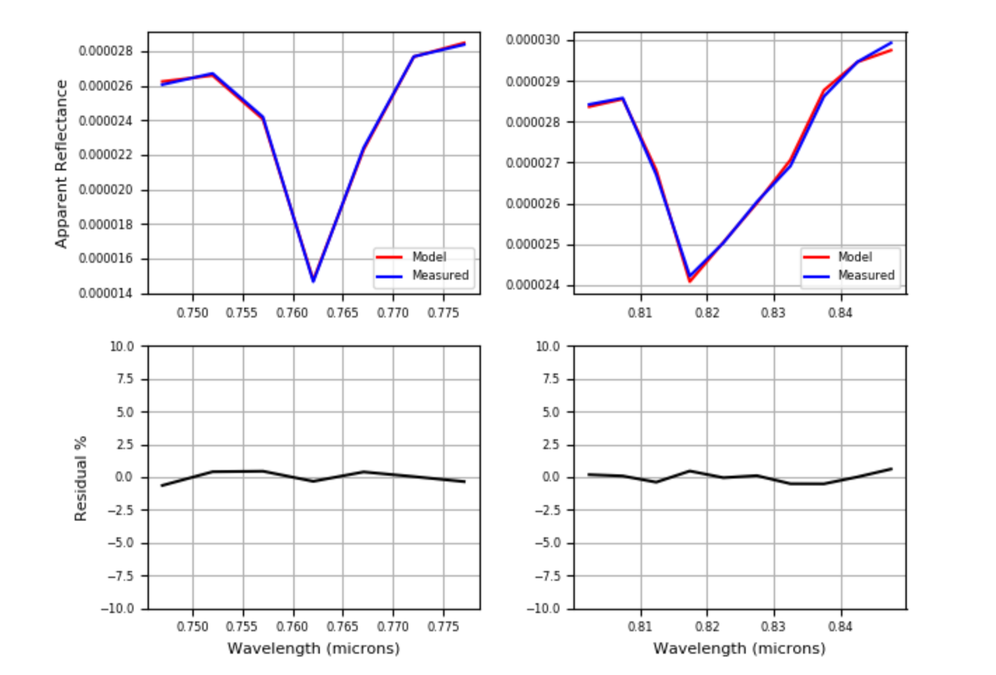
Wavelength fitting example
Apparent reflectance
Apparent reflectance
[Thompson et al., Atmos. Meas. Techniques 2015]
Residual error
Residual error
Common features used for this purpose include the oxygen A band (760 nm) and Near-Infrared H₂O vapor absorptions

Slide 9
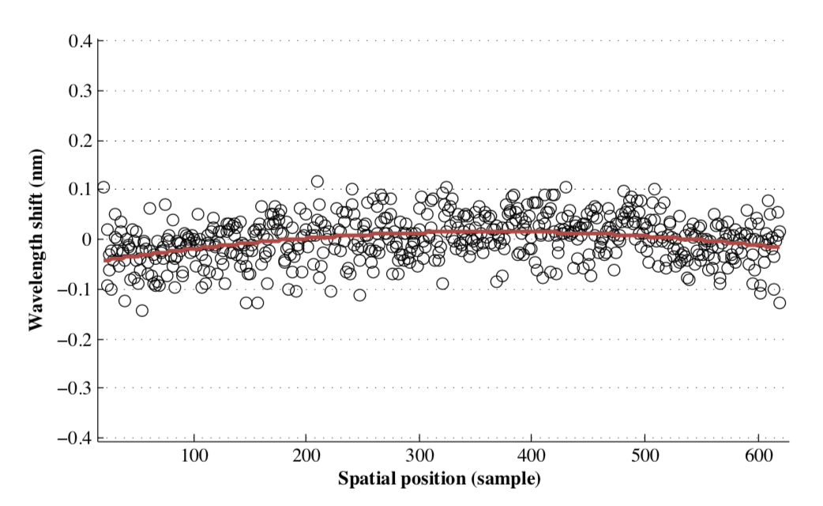
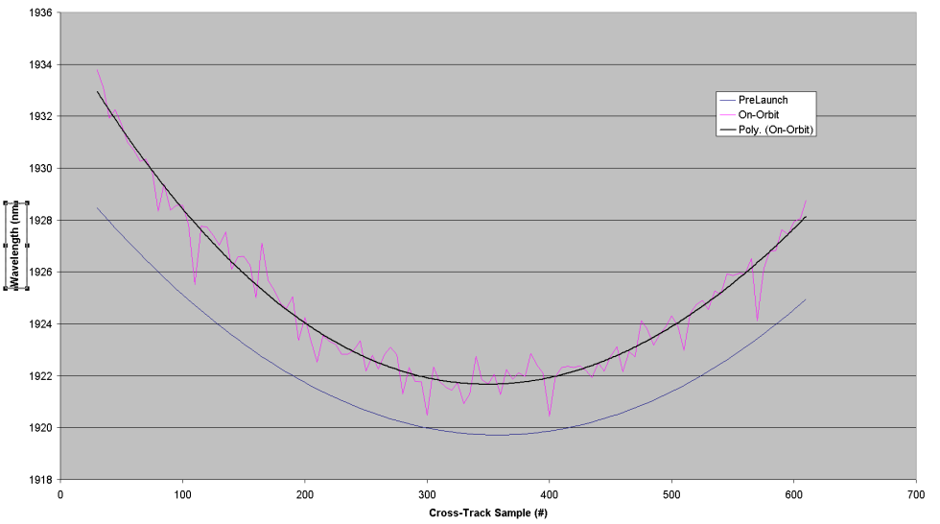
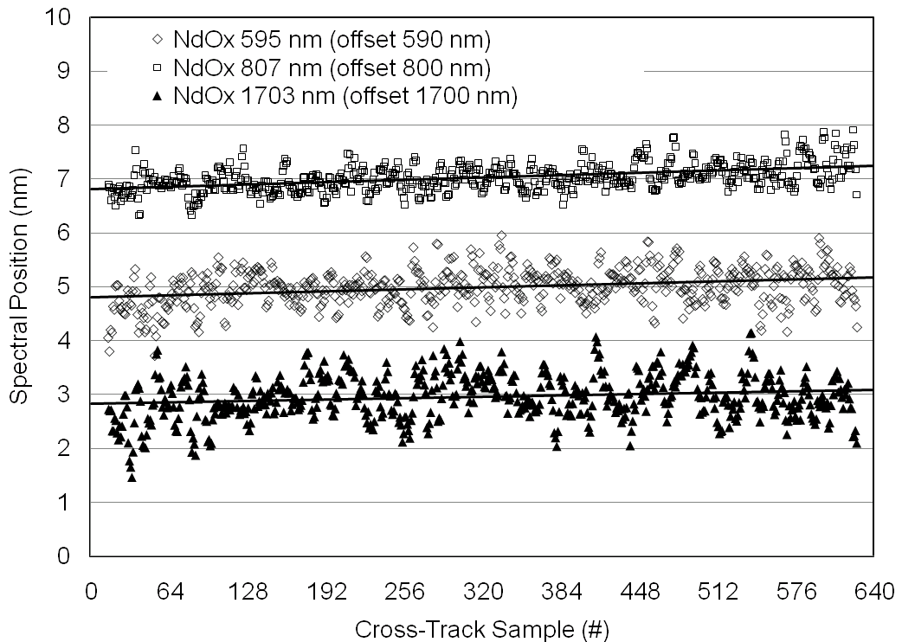
Uniformity achieved
(courtesy Robert O. Green, JPL, and others)
AVIRIS-NG
[Thompson et al., AMT 2015]
CRISM 2005
JPL M3 2008
Hyperion 2000

Slide 10
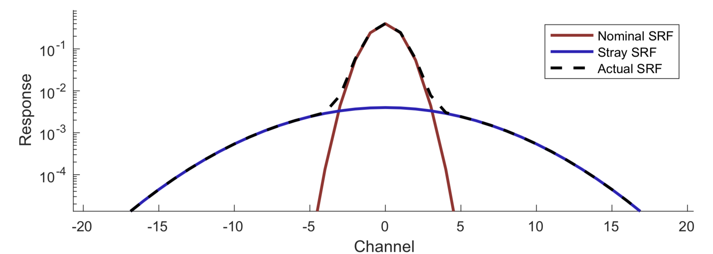
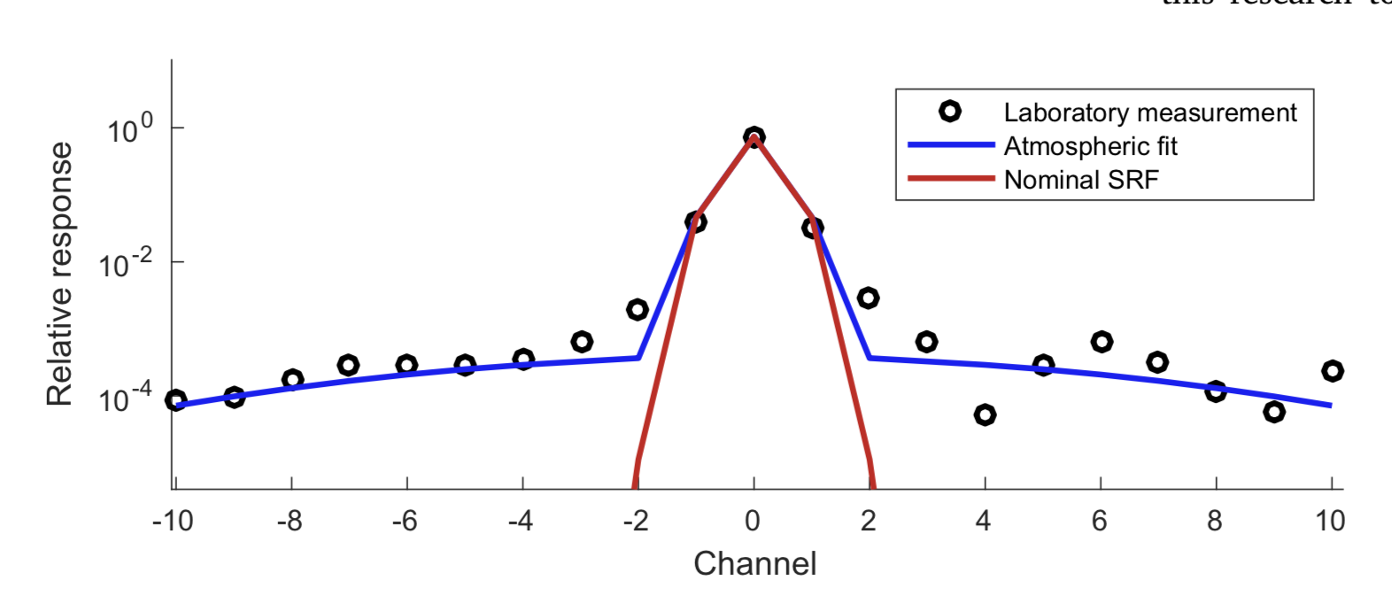
“Stray” spatial / spectral response functions

Slide 11
Measurement model
Scene model
n = number of crosstrack samples
d = number of spectral channels
C = crosstrack stray light
S = spectral stray light
Solar Irradiance
Predicted Radiance
At Focal Plane Array
Measured Radiance
At Focal Plane Array
Ideal PSF
“Extra” CRF
“Extra” SRF
Atmospheric Attenuation, Scattering
(L_{pred} C)^{T} S = L_{meas}
Surface Reflectance
[d x n]
[n x n]
[d x d]
[d x n]

Slide 12
Method
Find well-constrained properties of scenes’ true radiance
Posit the functional forms of the CRF and SRF
Optimize free parameters to match observations via:
Correct future data using the following linear transformation:
Here, ⁺ represents the Moore-Penrose inverse, e.g.
(L_{pred} C)^{T} S = L_{meas}
[d x n]
[n x n]
[d x d]
[d x n]
L_{corr} = ((C^{T})⁺ ((S^{T})⁺ L_{meas}^{T} ) ^{T} ) ^{T}
C⁺ = (C^{T} C)⁻¹ C^{T}
C⁺C = I

Slide 13
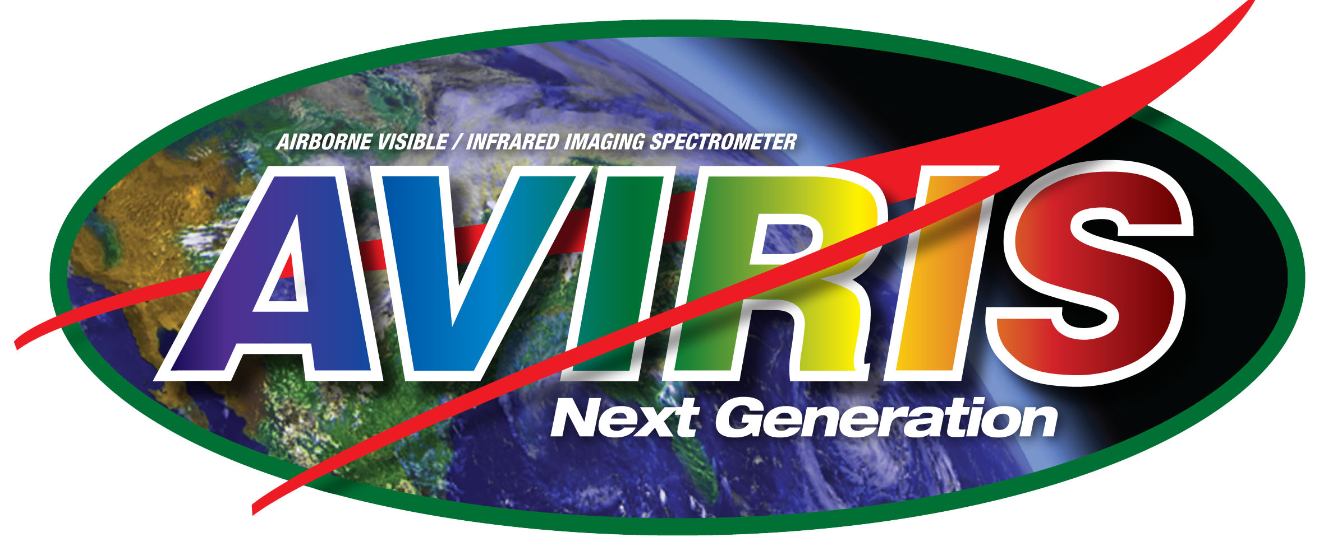
Procedure
Exploit the predictable shape of the O₂ A band
Find a haze-free day to constrain path radiance
Calculate “true” A band based on elevation and sensor altitude
Dataset: Death Valley transect, a large elevation gradient
A band
N
4000 m
Surface Elevation
-80 m
3200 m

Slide 14
Atmospheric fitting of PSF Tails
Pressure Altitude Retrieval Before SRF Correction
After SRF Correction
Results from Thompson et al., RSE 2018
In-Flight SRF Estimate via Atmospheric Fitting
Laboratory Measurement of Subpixel Stimulus
Nominal Response Function
Spectral dimension
Spectral dimension
Spectral dimension
Spatial dimension
Spatial dimension
Spatial dimension

Slide 16
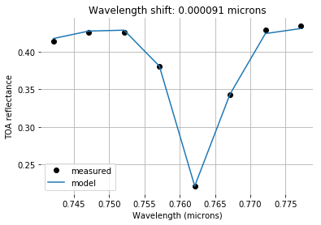
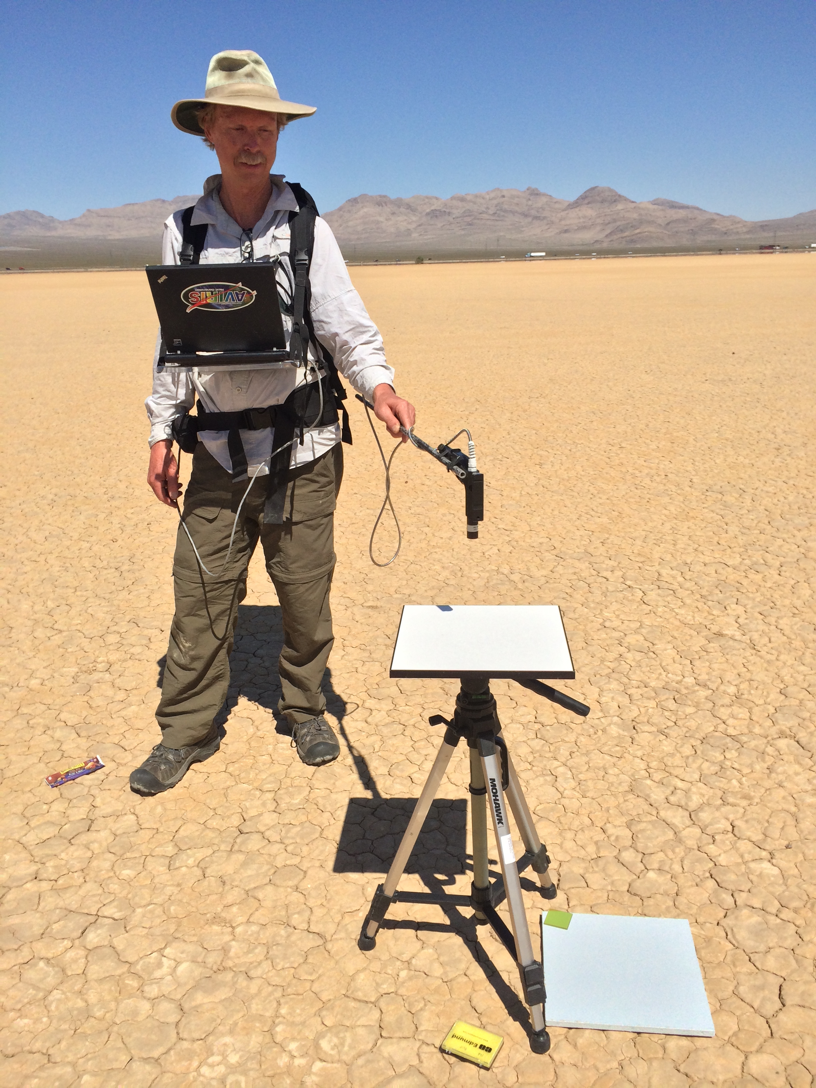
Exercise 8: Spectral Calibration
Objective: Use the atmosphere as a calibration object. Fit a modeled transmission spectrum to TOA observations.
Files include two examples of TOA reflectances acquired by the AVIRIS-NG instrument onboard a b-200 aircraft over Ivanplah playa. The exercise notebook contains fitting routines, and a transmission spectrum for appropriate observing geometry and water vapor loadings.
Pick an atmospheric feature, and eyeball an initial calibration. Start with a spectral response function that is 5-6 nm Full Width at Half Maximum. Then, fit wavelength shifts to fine tune your initial guess. Is there a way of quantifying how accurate this method can be?

